Slide 1
.NET 8 CI and Docker with Reusable GitHub Actions
Streamlining development with automated workflows and tools
Notes:
AI-generated content may be incorrect. ---

Slide 2

Overview of the CI/CD POC
Reusable CI/CD Architecture
CI/CD logic is centralized in reusable workflows separate from application code, promoting scalability and standardization.
Separation of Repositories
Templates repository holds pipeline logic while application repository remains lightweight with source code and workflow callers.
Pipeline Stages Demonstrated
The POC showcases build, test, publish, Docker image build and push, and optional deployment in a governed pipeline.
Notes:
This proof-of-concept demonstrates a modern, reusable, and scalable CI/CD approach for .NET 8 applications using GitHub Actions. The architecture is intentionally designed to separate reusable CI/CD logic from application code by leveraging GitHub Actions reusable workflows through workflow_call. All pipeline intelligence—including build, test, publish, Docker build and push, and deployment—is centralized in a dedicated templates repository known as REPO1. The application repository, REPO2, remains intentionally lightweight, containing only the application source code, Dockerfile, and thin workflow callers that invoke the shared templates. This separation allows multiple application teams to standardize CI/CD practices while minimizing duplication and maintenance effort. The goal of the POC is to demonstrate how to create both repositories from scratch, push code from local development environments, execute CI stages such as build, test, and publish, build and push Docker images, and optionally trigger deployment workflows using a consistent and governed pipeline strategy.

Slide 3
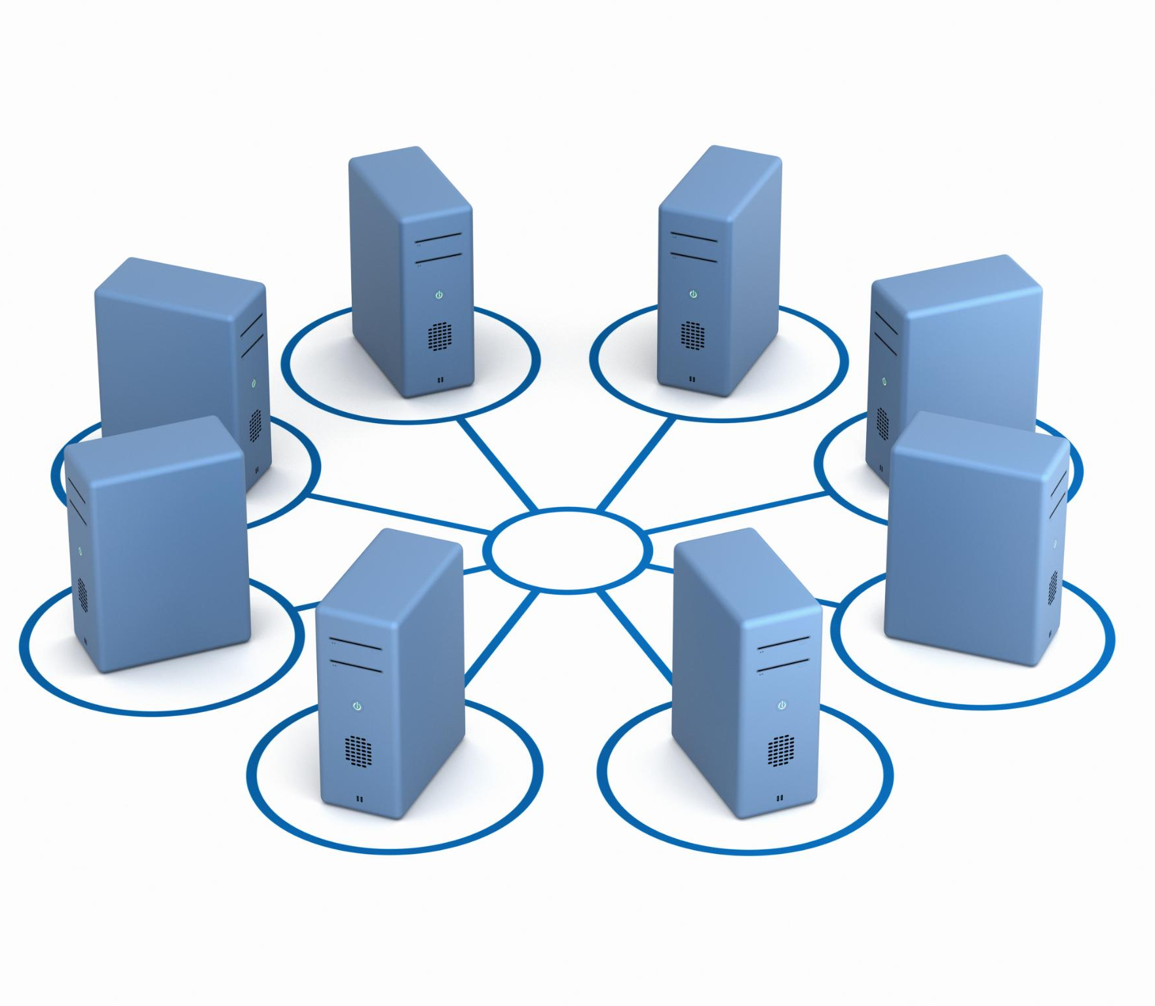
Primary Objectives
Two-Repository Model
Implement a clean two-repository structure separating reusable workflows and application code to streamline CI/CD management.
Reusable GitHub Workflows
Use reusable GitHub Actions workflows to standardize and simplify automation across projects and teams.
Automated CI/CD Pipelines
Enable automatic build, test, publish, and Docker image creation triggered by code pushes or pull requests.
Scalable Deployment Automation
Support optional deployment workflows to extend automation to infrastructure and runtime environments for scalability.
Notes:
The primary objectives of this CI/CD implementation are to establish a clean two-repository model, demonstrate reusable GitHub Actions workflows, and enable consistent automation across projects. The process begins with creating REPO1 to host all reusable workflow templates and REPO2 to host the .NET 8 application. From there, developers push code locally to trigger CI pipelines automatically on push or pull requests. The workflows orchestrate build, test, publish, and Docker image creation, with optional Docker push to a registry. The design also supports optional deployment workflows, allowing organizations to extend automation to infrastructure and runtime environments. Together, these goals ensure scalability, maintainability, and standardized CI/CD execution across multiple teams and projects.

Slide 4

Two-Repository Architecture
Separation of Concerns
Two repositories separate reusable CI/CD logic from application-specific code for clearer architecture and maintenance.
Templates Repository (REPO1)
REPO1 holds reusable workflows for build, test, publish, Docker operations, and deployment to be shared across projects.
Application Repository (REPO2)
REPO2 contains the .NET 8 source code, Dockerfile, and minimal workflows that call templates from REPO1.
Benefits of Architecture
This architecture ensures project consistency, simplifies onboarding, and enables centralized CI/CD improvements.
Notes:
The solution is built on a clear two-repository architecture that separates concerns between reusable CI/CD logic and application-specific code. REPO1, known as the templates repository, contains all reusable workflows for critical pipeline stages such as build, test, publish, Docker build, Docker push, and deployment. These workflows are defined under the .github/workflows directory and are designed to be called by other repositories via workflow_call. REPO2, the application repository, contains the .NET 8 source code, Dockerfile, and minimal workflow definitions that invoke the templates in REPO1. This architectural separation ensures consistency across projects, simplifies onboarding for new repositories, and allows CI/CD improvements to be rolled out centrally without rewriting pipelines for each application.

Slide 5
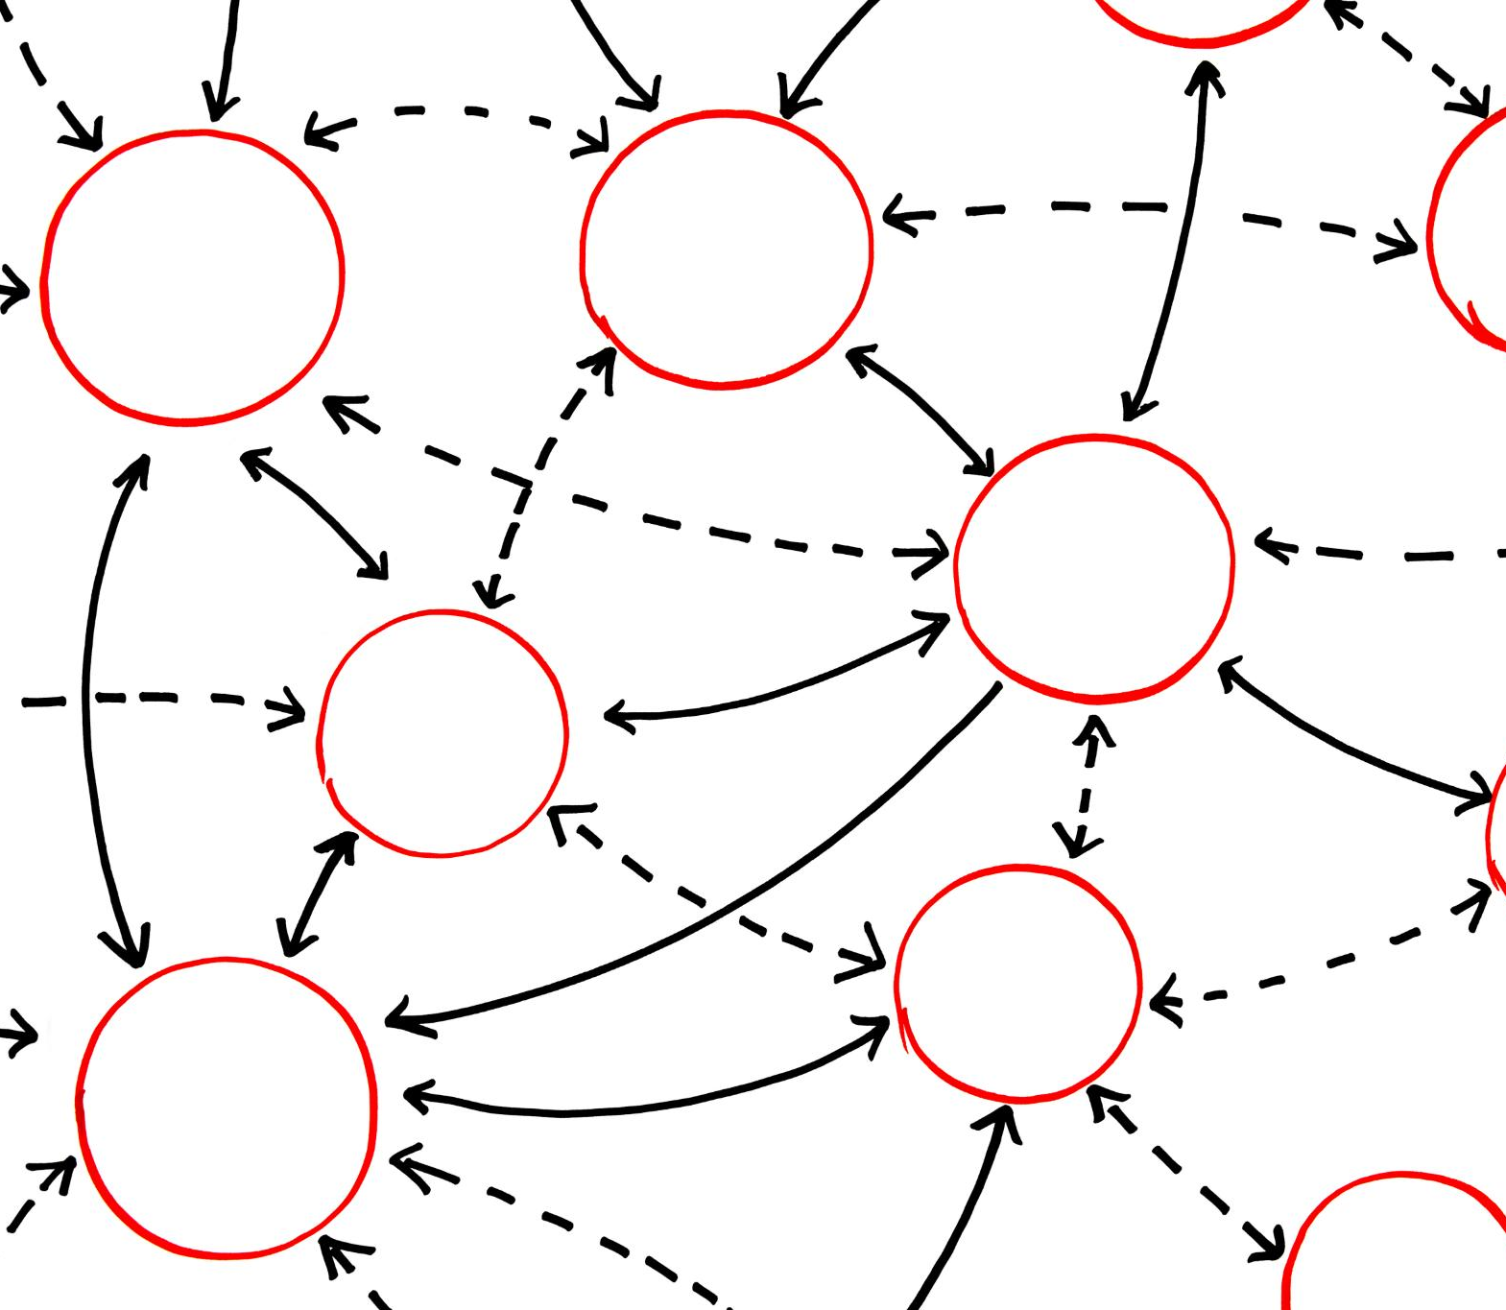
Why Reusable Workflows
Centralized Pipeline Logic
Centralizing pipeline logic prevents duplication and reduces errors across multiple repositories in CI/CD environments.
Single Source of Updates
Updates to build logic or security are made once in templates and used across all projects seamlessly.
Clear Contracts and Security
Reusable workflows define explicit inputs and secrets, ensuring secure parameter passing without embedding sensitive data.
Governance and Scalability
This approach promotes governance, standardization, and scalable continuous improvement in CI/CD processes.
Notes:
Reusable workflows provide significant advantages in enterprise CI/CD environments. By centralizing pipeline logic, teams avoid YAML duplication across multiple repositories, reducing errors and maintenance overhead. Updates to build logic, security practices, or tooling versions can be made once in the templates repository and consumed by all application repositories when they update their workflow reference tag. Additionally, reusable workflows enforce clear contracts by explicitly defining inputs and secrets, ensuring caller repositories only pass required parameters without embedding sensitive information. This approach promotes governance, standardization, and scalability while supporting continuous improvement in CI/CD processes.

Slide 6

Prerequisites and Setup
Developer Tools Setup
Git and GitHub accounts are essential for version control and repository management before starting CI/CD pipelines.
.NET SDK Installation
.NET SDK 8 must be installed locally to validate builds and tests prior to triggering continuous integration.
Docker and Container Registries
Docker is optional but recommended; container registries enable storing container images for deployment in CI/CD.
Local Validation Best Practices
Validating dotnet restore, build, test, and publish locally reduces CI failures and ensures smoother pipeline execution.
Notes:
Before implementing the CI/CD pipelines, several prerequisites must be met to ensure smooth setup and execution. Developers should have Git installed locally and access to a GitHub account with permissions to create repositories. The .NET SDK 8 should be installed locally to validate builds and tests before triggering CI. Docker installation is optional for local development but recommended; however, Docker builds can also be executed entirely on GitHub-hosted runners such as ubuntu-latest. Optional components include a container registry such as Azure Container Registry, Docker Hub, GitHub Container Registry, or a private registry, as well as a deployment target like AKS, App Service, or AAP job templates. Validating dotnet restore, build, test, and publish locally before pushing changes helps reduce CI failures.

Slide 7

CI, Docker, and Deployment Flow
Automated CI Workflow
Pushing code triggers CI workflows that build, test, publish, and create Docker images sequentially using dependency chains.
Docker Image Management
Docker images are built, saved as artifacts, and optionally pushed to container registries with secure secret management.
Secure Secrets Handling
Secrets are securely stored and passed only within application repos, keeping template repositories free of sensitive data.
Flexible Deployment Workflow
Deployment workflows support manual triggers, multi-site deployments using matrix strategies, and integration with external systems.
Notes:
Once the repositories and workflows are configured, the CI/CD flow operates automatically. Pushing code to the main or master branch in REPO2 triggers the CI workflow, which sequentially calls reusable templates for build, test, publish, and Docker image creation using the needs dependency chain. Docker images are built and saved as artifacts, with optional push to a configured container registry once secrets are enabled. Secrets are stored exclusively in the application repository and passed securely to reusable workflows, ensuring template repositories remain secret-free. Optional deployment workflows can be triggered manually using workflow_dispatch, supporting multi-site deployments through matrix strategies and integration with external systems like AAP. This end-to-end flow ensures consistent, traceable, and governed automation from code commit through deployment.

